Slide 1
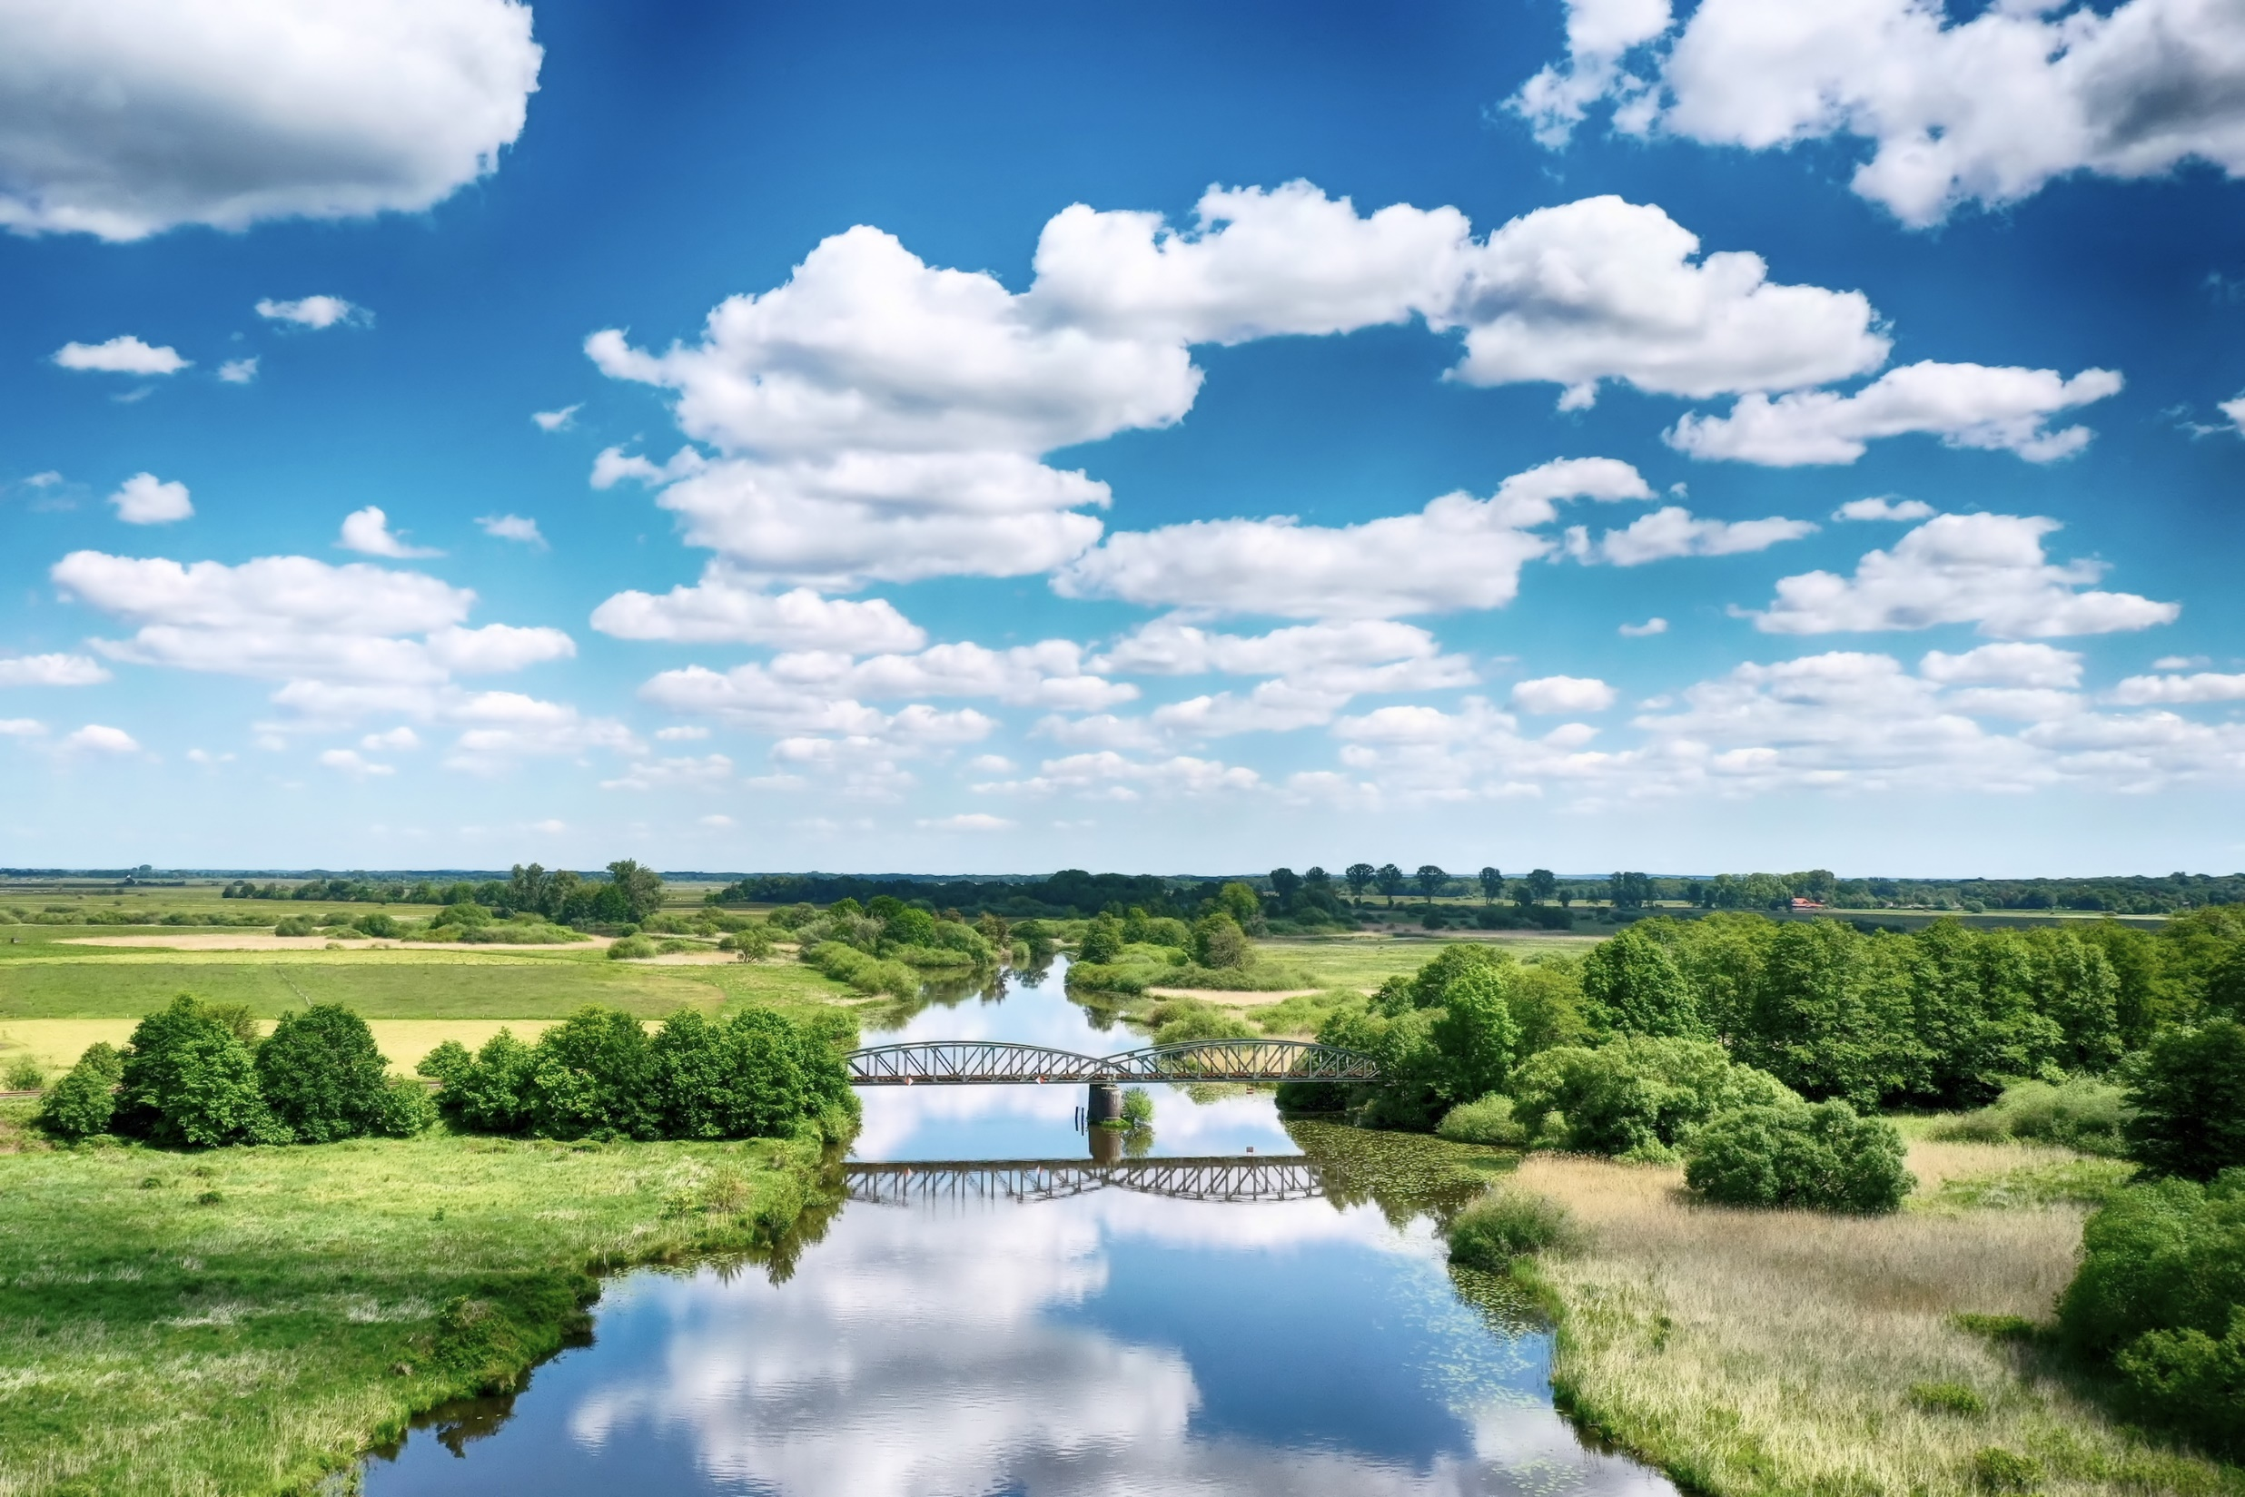
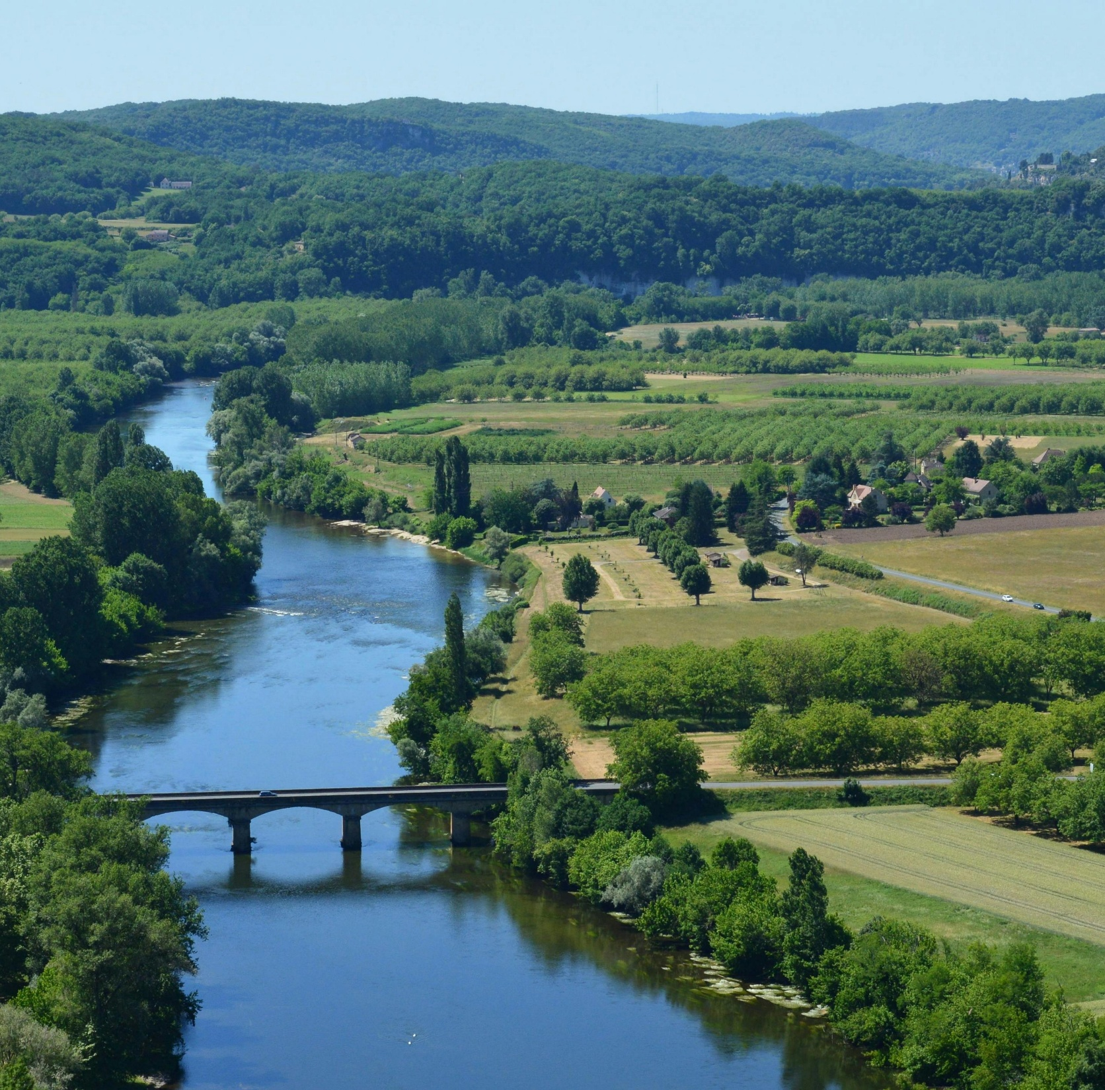



SpongeWorks – Pinios Demonstrator, GR
Tackling water scarcity and drought through integrated water resource management – From field to landscape together with stakeholders
Andreas Panagopoulos, Anna Chatzi
Hellenic Agricultural Organisation -
Soil and Water Resources Institute (SWRI)

Slide 2
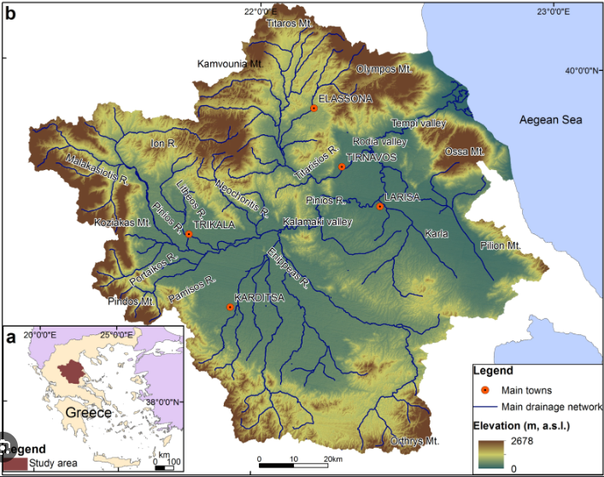
Pinios Basin: A water-stressed agricultural basin
11.000 km²
River basin
700.000+
Population
~95%
Freshwater consumption by agriculture
400-1.800 mm
Precipitation variability
Hot and dry summers
Strong spatial (temporal) variability
Agriculture dominates
Water deficit and quality pressures
GW>80%, ca 4Bm³ (1985-2025)
Fragmented governance structures
Agriculture is at the centre of both the water challenge and the opportunity for action!

Slide 3
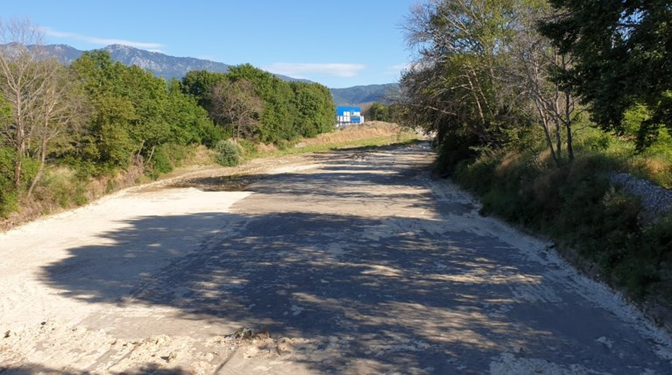
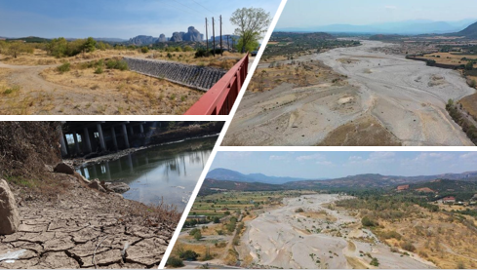
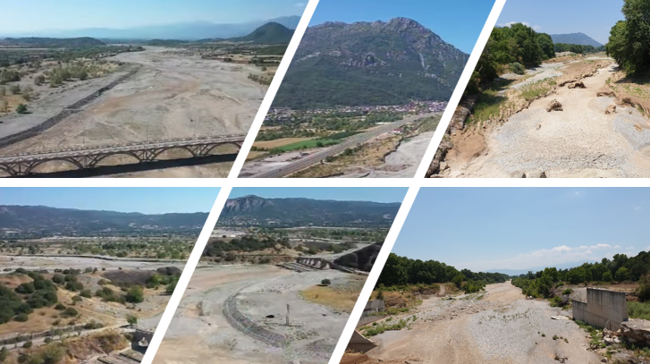
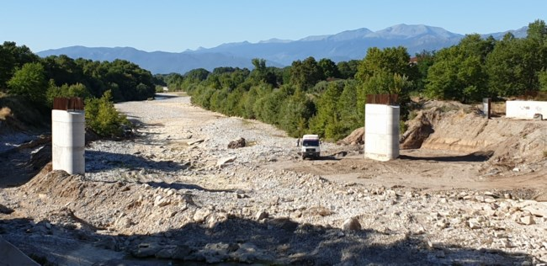
Water scarcity & direct impacts
June 2020 - Pinios river dried in Trikala area
August 2021 - Pinios river dried at about 25km length (from its sources to Dialekto settlement in Trikala)
August 2022 - Pinios river dried for the fifth consecutive year in the area of Trikala
The Toc news
The Toc news, Ethnos news, Ant1 Tv, Lifo news
Thessaly Tv
💧 WATER SCARCITY
Reduced water availability
⚡ HIGHER COSTS
Higher irrigation & energy costs
🌾 YIELD LOSSES
Lower agricultural productivity
Repeated drought events are becoming a structural challenge for the Pinios agricultural system...
...often preceding extreme flood events. Both triggering discussions on fundamental land use changes

Slide 4
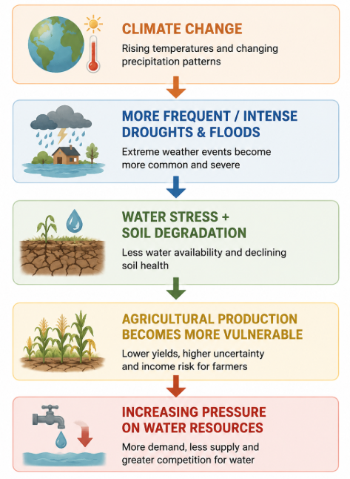
Water scarcity is a system challenge…
Pinios River basin faces…
Water stress
Water deficit + Quality deterioration
Agricultural vulnerability
Insecure production + Economic pressure, shift rainfed crop
Landscape degradation
Soil erosion + Low soil organic matter + Desertification pressures
Governance
Fragmented responsibilities + Need for coordinated action

Slide 5


Landscape-scale resilience through stakeholder engagement
🌱 Testing practical solutions
NbS 1 - Effective soil water management through irrigation scheduling
NbS 2 - Increasing soil organic matter through agroecological practices
Both solutions are now incorporated as evaluation sites within SpongeWorks
🌍 Scaling and integrating measures
Combining measures across the landscape
Assessing their contribution to water resilience
Moving towards integrated water-resource management
🤝 Stakeholder engagement
Stakeholders from different levels
Different sectors and interests
Created a diverse stakeholder pool for collaborative action
REXUS built the stakeholder network & laid foundation for NbS measures →
LENSES tested solutions →
SpongeWorks is taking the next step towards landscape-scale water resilience
A shift from experimental tests to operationalised implementation

Slide 6
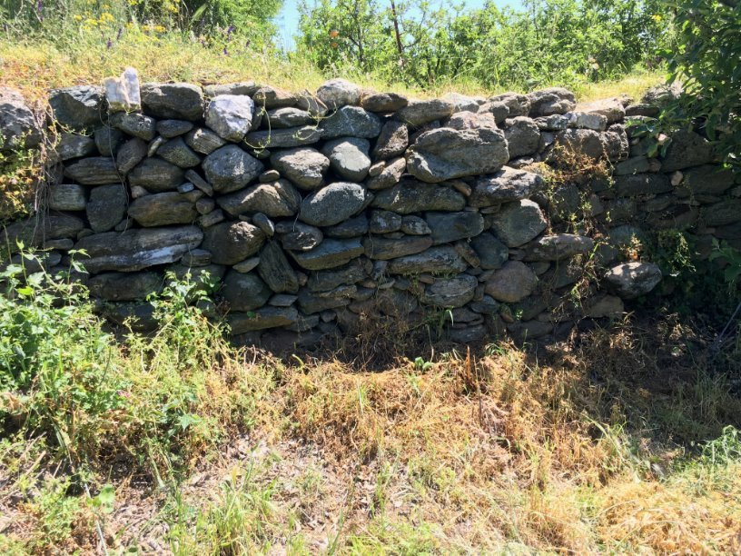
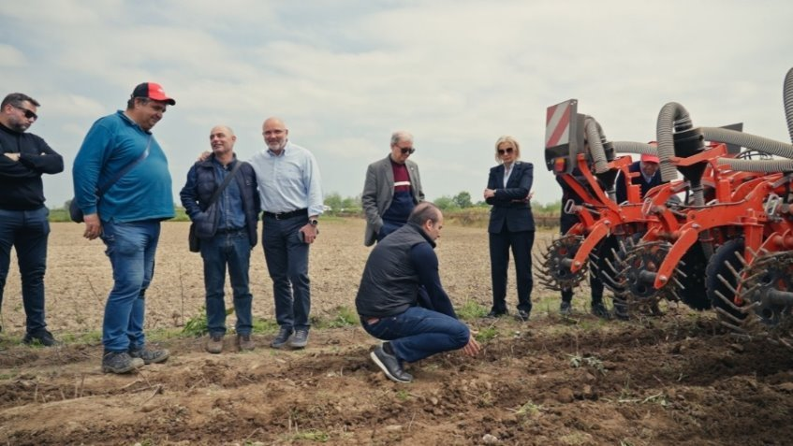
From water scarcity to sponge landscapes
🌱 Soil
Systematic mulching
Low/no-tillage & soil management
Terraces for harvesting/reusing soil water
Building water resilience through connected measures…
From soil and fields to landscapes, rivers and peri-urban areas!
🚜 Agricultural field
Soil water management through irrigation scheduling
🌳 Riparian system
Riparian forest
🌾 Landscape
Buffer strips
Hedges
🏘️ Urban & Peri-urban areas
Mulching with wood chips from pruning activities

Slide 7

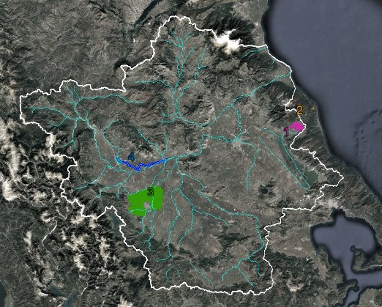


Spatial extent of intervention areas
1 - Agia plain - Implementer: Municipality of Agia (DIMAG) | 200ha-350 fields-43 farmers
Testing sponge measures under different local conditions
2 - Melivia area - Implementer: Melivia Cooperative (ACM) | 35ha-50 fields-18 farmers
3 - Tavropos area - Implementer: TOEV Tavropou (TAV) | 350ha -buffer strips (20kmx4m) & hedges (28kmx1m) - 150 fields - 15 farmers
4 - Trikala area - Implementer: e-Trikala | Riparian forest (2.7kmx4m) & spongePark - 2ha

Slide 8
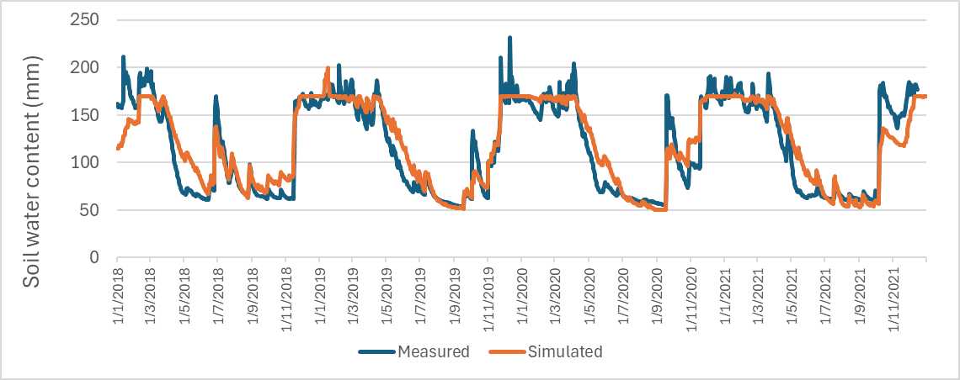
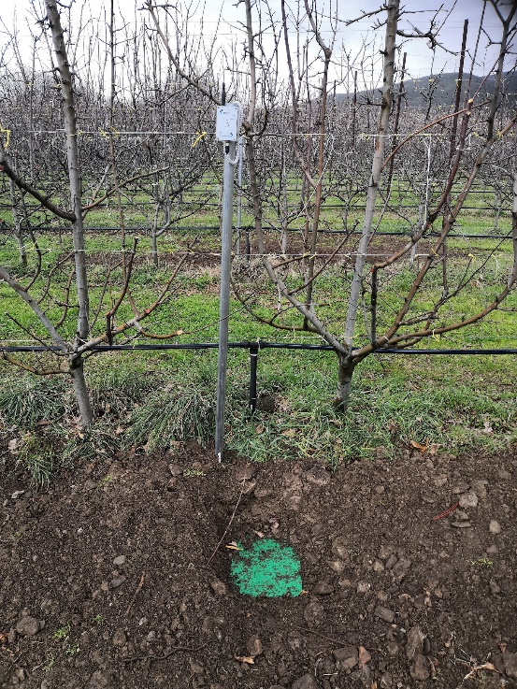
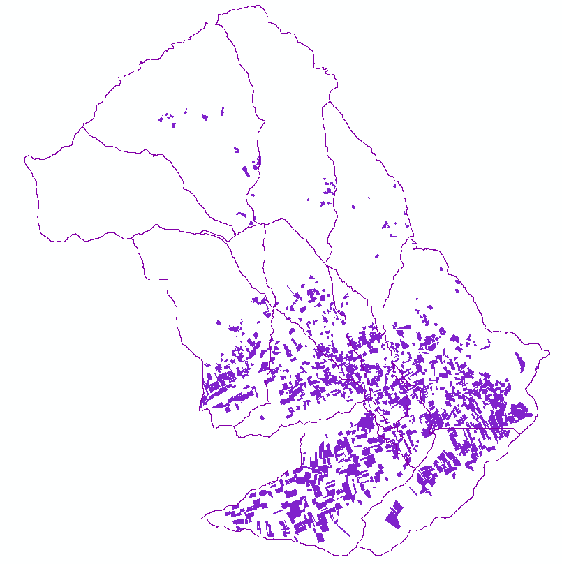
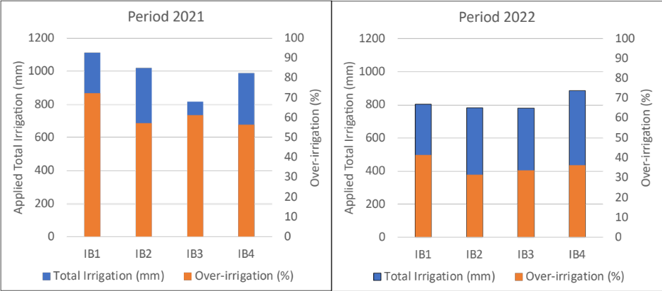
NbS1: Effective soil water management through irrigation scheduling
Current irrigation practice for apples:
Empirical practice -> fixed days, 1 irrigation event per week, as much as possible, late May – mid Sep
670 mm per irrigation period, based on data from telemetric water meters
Irrigation scheduling
Implementation of the auto-irrigation algorithm of SWAT model. Water stress based on plant water demand
Apples
770 ha
68 HRUs
Reduction of apples’ irrigation water consumption:
On average by 22%
From 670 mm to 520 mm

Slide 9
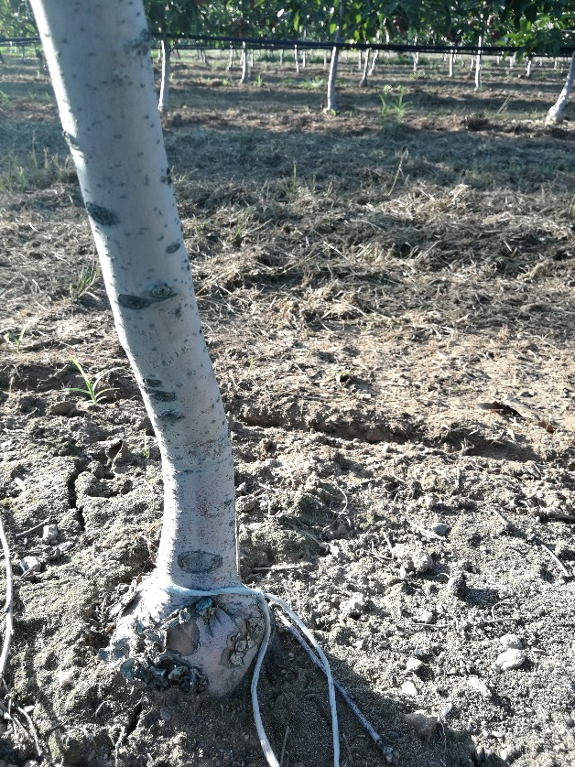
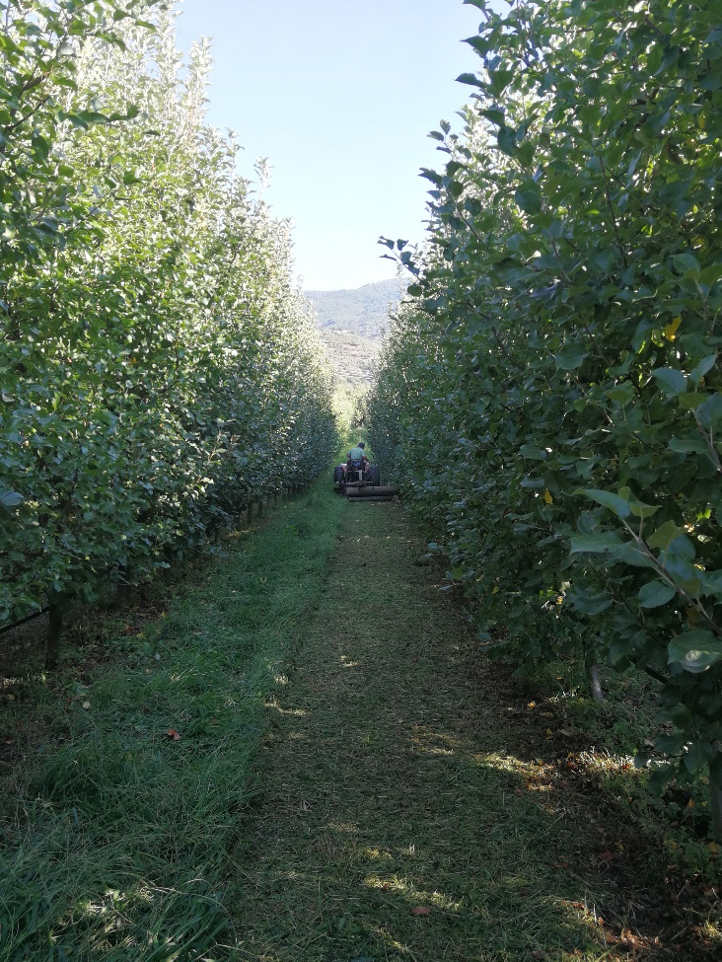
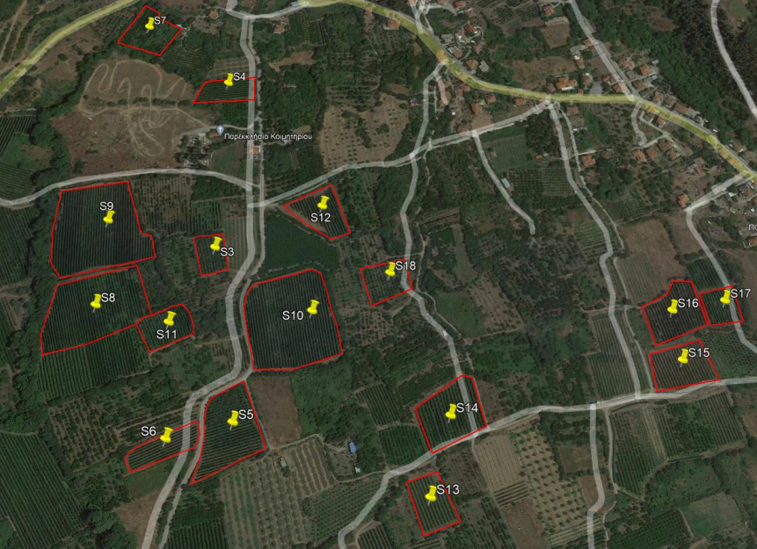
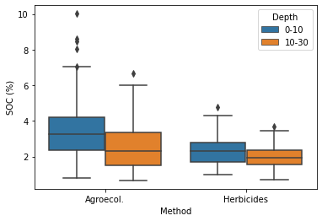
NbS2: Increasing soil organic matter through agroecological practices
Year 2022 and 2023 – 16 fields, 8 applying mowing/mulching and 8 applying herbicides, 532 soil samples
Field applying herbicides
Field applying mowing/mulching
Soil Organic Content (SOC) at fields applying mowing/mulching compared to fields applying herbicides was found to be on average:
1.2% higher at 0-10 cm depth
0.6% higher at 10-30 cm depth
Increasing soil organic matter though agroecological practices in Pinios Hydrologic Observatory

Slide 10
From technical potential to real-world implementation
Moving from "good ideas" to implementation
TECHNICAL POTENTIAL
⬇
REAL-WORLD IMPLEMENTATION
Farmer commitment
Machinery availability
Cost
Time and labour
Agronomic uncertainty
Land-use conflicts
Regulation
Weather
Coordination
⚠️ A technically effective sponge measure may still fail to scale if it does not fit the realities of implementation and maintainance and if it is not
owned by the implementer
Prioritization-consideration of end-users
(Water managers'perspective does not necessarily coincides to that of implementers)

Slide 11
Building evidence for impact
IMPLEMENT
MONITOR
ASSESS
Sponge measures deployed on the ground
Four dimensions of impact
💧 Water retention
🧪 Water quality
🌱 Biodiversity
👥 Socio-economics
Evidence of environmental and socio-economic impact
The goal: turn implementation into measurable evidence of impact
Evidence is what allows successful approaches to be transferred and scaled

Slide 12
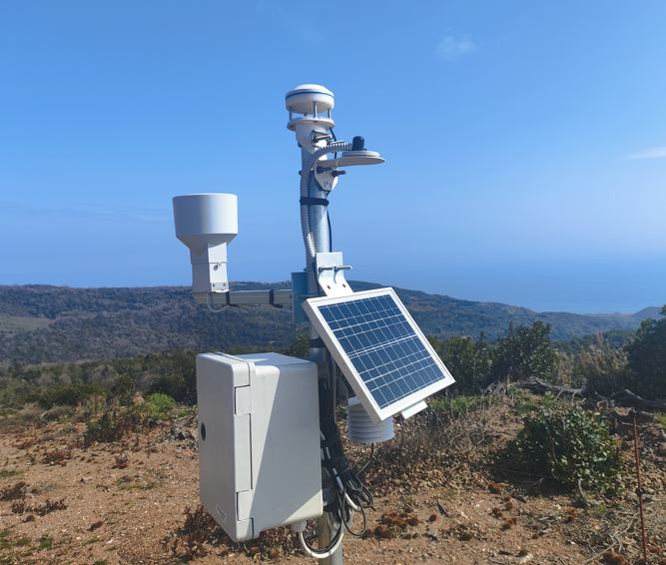
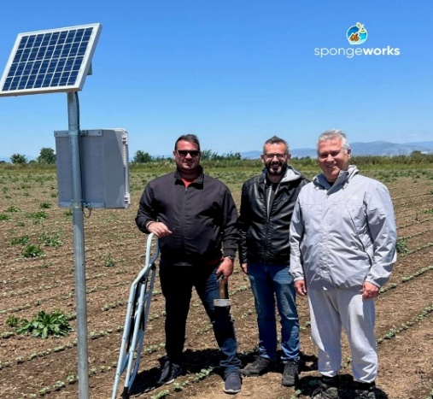
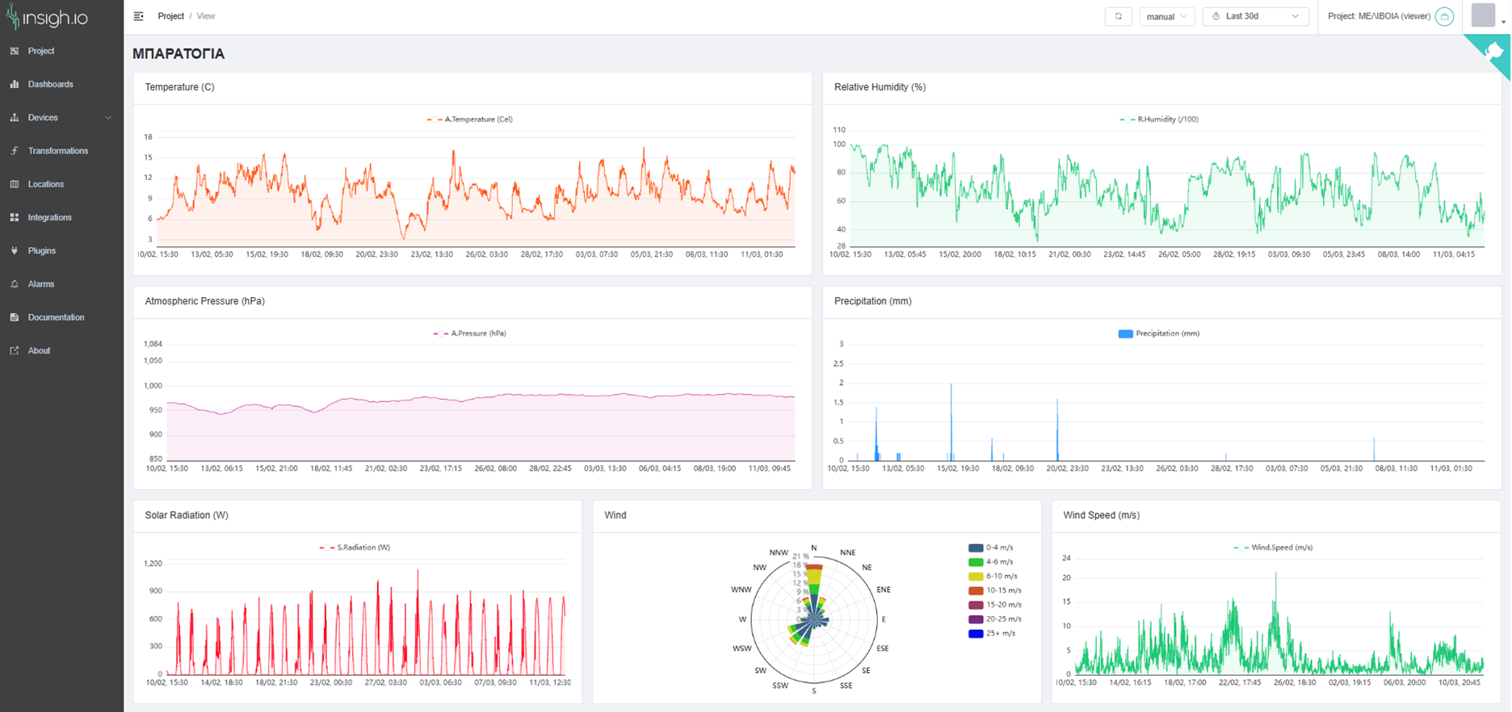
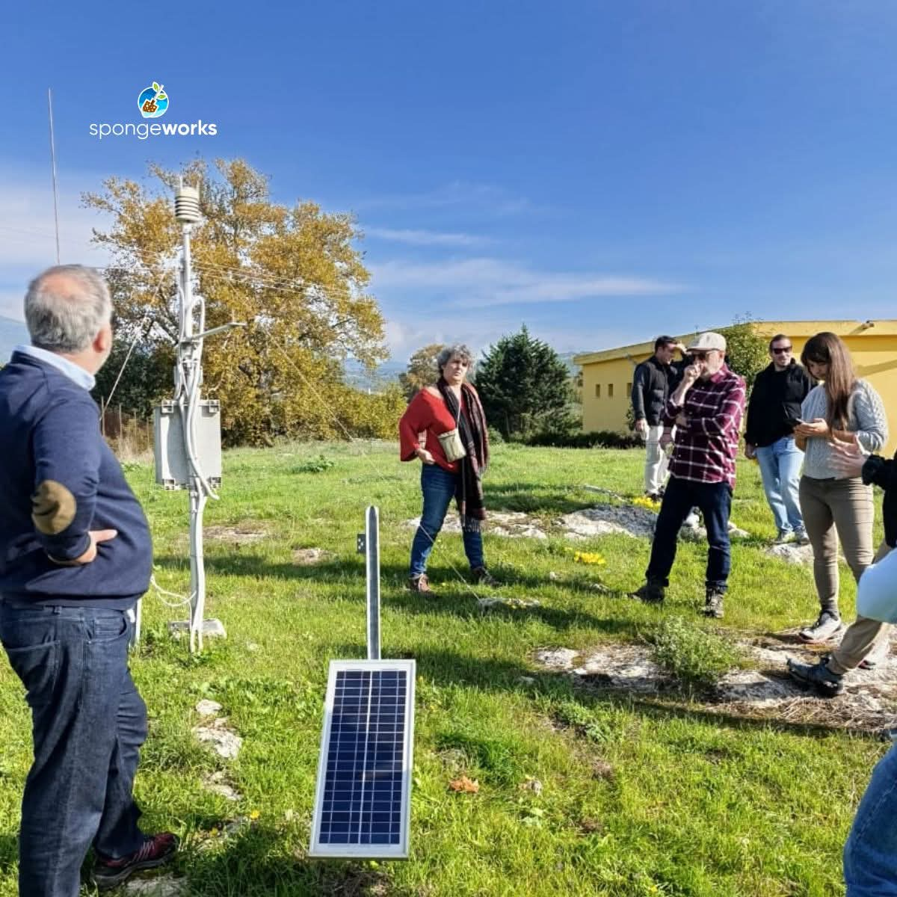
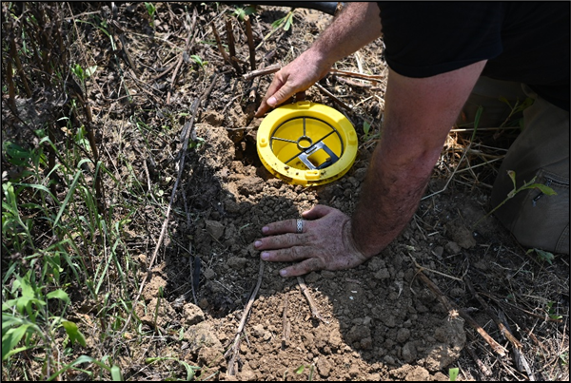
Monitoring resilience in the field
Sensors installed across the Pinios demonstrator sites
From field measurements to evidence
Soil water content – depth 0,15m
SWC (%)
Monitoring moves us from ‘implemented’ to ‘measurable effect’
&
Feed self-assessment tools that promote ownership

Slide 13
What are we learning?
Early lessons from implementation…
Evidence matters - Monitoring demonstrates environmental, economic and social benefits.
Implementation is multi-actor - Farmers, authorities, water managers, CoPs and technical organisations need to be involved
Incentives matter - Long-term adoption requires viable economic and institutional conditions
Context matters - Measures must fit local agricultural, environmental, capacity and governance conditions
The measure is only part of the solution…
Successful implementation requires:
Context • People • Incentives • Evidence
Scaling means replicating the conditions for success, not simply replicating the measure…

Slide 14
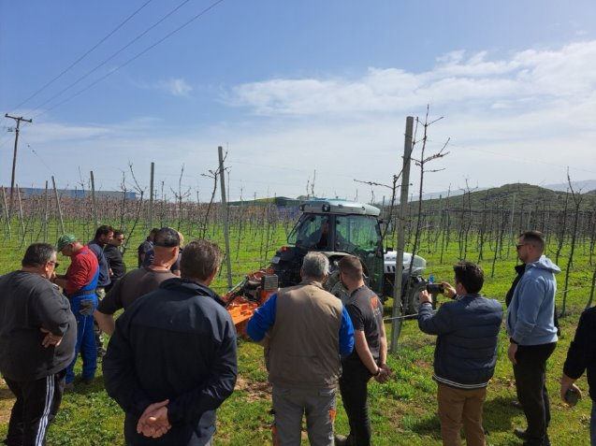
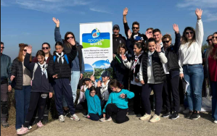
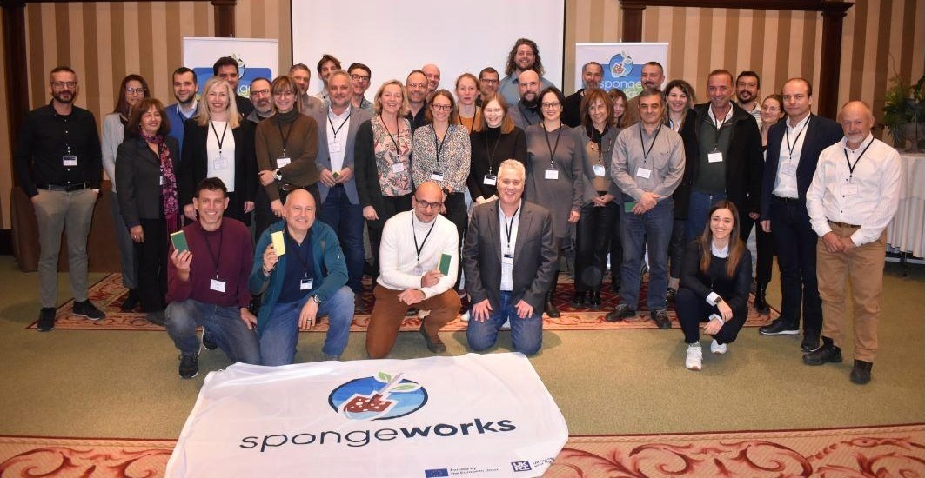
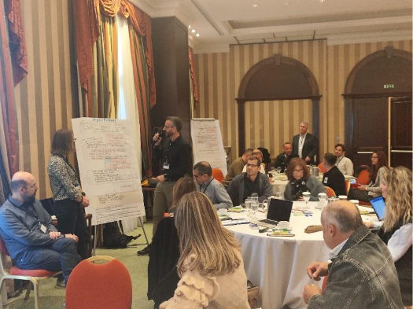
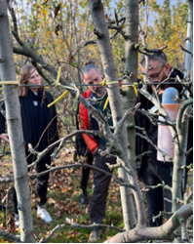
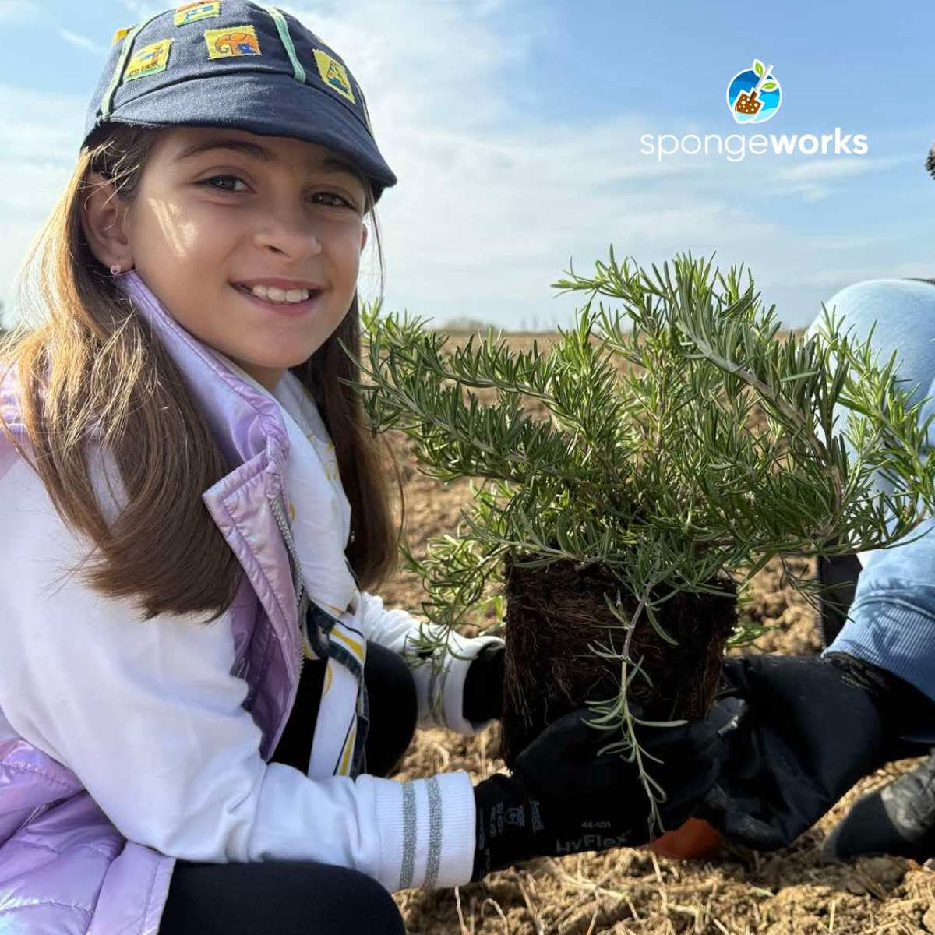
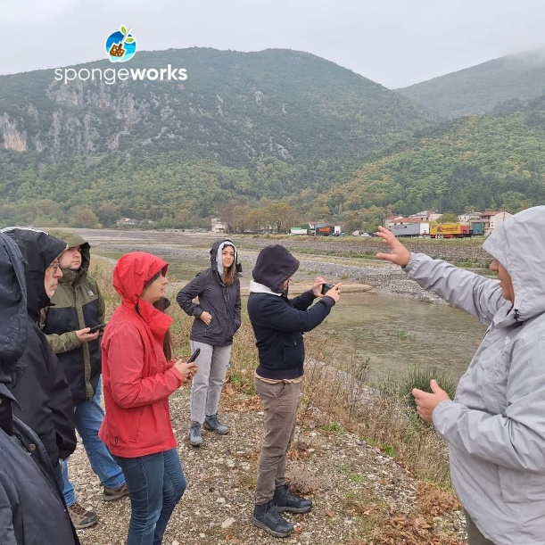
Work closely with stakeholders
Development of scenarios that take into account the existing conditions, including all socio-ecological and technical challenges
Development of scenarios that leverage the “supportive elements” and address the “constraints” of the current governance system, in order to identify where changes are required and where changes can realistically occur
2nd Technical Workshop (Geodesign Workshop) 05/2026
Field Day – Demonstration of mechanical weed control machinery 06/2025
1st Technical Workshop (Knowledge Integration Workshop) 11/2025
Field Day - Demonstration of strip tillage machinery 04/2025
Demo basin Kick-off meeting (DBKO) 11/2024

Slide 15







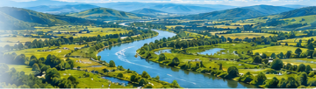

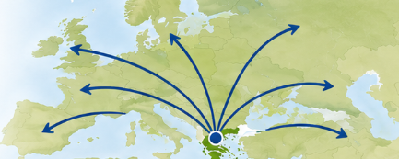

From Local Action to European Impact
Scaling knowledge, measures and partnerships for lasting water resilience–towards the 2050 vision
For farmers
Demonstrate practical, economically viable solutions, in an enabling environment
FIELD
Individual + combination of sponge measures
For local authorities
Enhance capacity, coordinate stakeholders and remove regulatory barriers
LANDSCAPE
Combination + replication of measures
For other regions
Adapt the approach to local environment, agricultural and governance conditions
RIVER BASIN
Integrated water-resilience strategy
Scale the approach, not just the measure
Adapt → demonstrate → build evidence → replicate
NATION -> EUROPE
Adaptation + Replication
ULTIMATE GOAL: 2050 VISIONING
A water-resilient Pinios Basin built through adapted measures, evidence and stakeholder-driven implementation.

Slide 16
Some takeaways
Facts & observations | The success
Communication yields results, so does the investment on CoPs enlargement & empowerment | Discovered believers at regulatory authorities that want to make a change Identified prospective adopters Started feeling the wind of change
Stakeholders are offered the stage to state their experience/viewpoints and shape the vision for Pinios River Basin | Multi-sectoral representation and open discussion built strong consensus on developing common understanding, and paving the way to strategic planning that merits wide acceptability
Visiting and discussing with implementers on real evidence brings in followers | Prospective implementers multiply Interest on replicating the measures is apparent
Farming community: low risk investors BUT seeks solutions for survival | Ready to follow if fully convinced - individual adoption of measures: show them the co-benefits they understand and care the most They embrace the measure if they own it

Slide 17











Thank you!
Andreas Panagopoulos: a.panagopoulos@elgo.gr
Decentralized Administration of Thessaly-Central Greece
Anna Chatzi: a.chatzi@elgo.gr
The SpongeWorks project has received funding from the ​European Union’s Horizon Europe research and innovation ​programme under grant agreement No 101156116. The ​project will run from 1 September 2024 to 31 August 2028.
Funded by the European Union. Views and opinions expressed ​are however those of the author(s) only and do not necessarily ​reflect those of the European Union. Neither the European Union ​nor the granting authority can be held responsible for them.

